Slide 1
Financial Stewardship Classes Greater Love Christian Fellowship
Budgeting 101

Slide 2
Topics of Discussion
What is a budget?
The C.A.R. concept!
Benefits of a budget
Budget example

Slide 3
What is a budget?
An estimate, often itemized, of expected income and expenses for a given period in the future
Itemized allotment of funds
Total sum of money set aside for or needed for a purpose.
A written cash flow plan

Slide 4
What is a budget?
Written cash flow plan
.

Slide 5
What is a budget?
Written cash flow plan
Habakkuk 2:2, ….Write the vision and make it plain on tablets, that he may run who reads it.

Slide 6
What is a budget?
Written cash flow plan.
Habakkuk 2:2, ….Write the vision and make it plain on tablets, that he may run who reads it.
As a wise steward you decide and allocate how God’s money is used.

Slide 7
What is a budget?
Written cash flow plan.
Habakkuk 2:2, ….Write the vision and make it plain on tablets, that he may run who reads it.
As a wise steward you decide and allocate how God’s money is used.
Prov. 21:20-21, Prov. 21:20-21 says, There is treasure to be desired and oil in the dwelling of the wise; but a foolish man spends it up…

Slide 8
What is a budget?
Written cash flow plan.
Habakkuk 2:2, ….Write the vision and make it plain on tablets, that he may run who reads it.
As a wise steward you decide and allocate how God’s money is used.
Prov. 21:20-21 says, There is treasure to be desired and oil in the dwelling of the wise; but a foolish man spends it up…
You control where the money goes rather than the money telling you.

Slide 9
What is a budget?
Written cash flow plan.
Habakkuk 2:2, ….Write the vision and make it plain on tablets, that he may run who reads it.
As a wise steward you decide and allocate how God’s money is used.
Prov. 21:20-21 says, There is treasure to be desired and oil in the dwelling of the wise; but a foolish man spends it up…
You control where the money goes rather than the money telling you.
Prov. 10:4, He becometh poor that dealeth with a slack hand: but the hand of the diligent maketh rich.

Slide 10
Think about it…
Most people hate the word budget because it has a bread and water connotation, and they never had a budget that worked.
The free spirit feels controlled (not cared for) and can appear irresponsible to nerds.
The nerd likes the budget because it gives them control, and they feel like they are taking care of loved ones.

Slide 11
The C.A.R. Concept
This concept is not only dealing with achieving financial peace, but a concept dealing with our priorities, our everyday living, and most importantly our relationship with God!
The 3 components of the C.A.R. concept consist of:
(C)ommitment
(A)ccountable
(R)esponsibile

Slide 12
Commitment
Derived from the root word “commit” which means to do or to perform
Act of committing, pledging, engaging oneself, or getting involved
A pledge or promise; obligation
Deut. 8:18

Slide 13
Accountable
State of being accountable, liable, or answerable
Subject to the obligation, obliged to accept responsibility
Liable to being called into account
Jer. 9:23-24

Slide 14
Responsible
Answerable, accountable for something within one’s power, control, or management.
Having capacity for moral decisions, capable of rational thought or action.
Able to discharge obligations or pay debts.
Reliable or dependable, as in meeting debts, conducting business dealings, etc.
I Tim. 6:17-19

Slide 15
Benefits of a written budget
Removes the “management by crisis” from your finances so that the money works harder and helps you make wiser money decisions. Prov. 28:20,22

Slide 16
Benefits of a written budget
Removes the “management by crisis” from your finances so that the money works harder and helps you make wiser money decisions. Prov. 28:20,22
If actually lived on and agreed on, will remove much of the guilt, shame and fear that may now be part of any necessity purchases like food or clothes.

Slide 17
Benefits of a written budget
Removes the “management by crisis” from your finances so that the money works harder and helps you make wiser money decisions. Prov. 28:20,22
If actually lived on and agreed on, will remove much of the guilt, shame and fear that may now be part of any necessity purchases like food or clothes.
Gives you empowerment, self-accountability, and control. I Tim. 6:6

Slide 18
Benefits of written budget
Removes the “management by crisis” from your finances so that the money works harder and helps you make wiser money decisions. Prov. 28:20,22
If actually lived on and agreed on (CAR), will remove much of the guilt, shame and fear that may now be part of any necessity purchases like food or clothes.
Gives you empowerment, self-accountability, and control. I Tim. 6:6
If actually lived on and agreed on (CAR), will remove many of the money fights from your marriage, and add a new level of unity to your marriage.

Slide 19
Are you ready?
“Adults devise a plan and follow it; children do what feels good.” Dave Ramsey
Zero based monthly budget example.
“Tell every dollar where to go.”
1st of every month- single or married
“You decide and commit to it.”

Slide 20
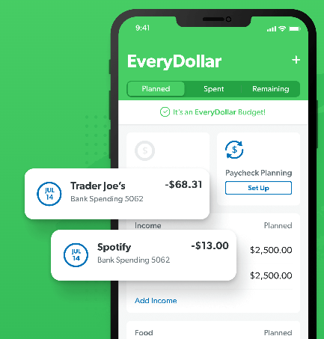
Next Assignment
“Adults devise a plan and follow it; children do what feels good.” Dave Ramsey
Create a monthly budget of your own or family.
You can use pin & paper, debt worksheet or
Dave Ramsey's Every Dollar app.
Two weeks gives you time to actually see what is coming
in and going out.
Next class is Feb. 18th- beginner emergency fund & spending
Debt Free Scream Video!

Slide 21
Questions
What questions do you have for us?

